Slide 2
Pre-Bid Meeting and On-Site Round

Slide 3
Agenda
Introduction to SPSC.
Functions and Responsibilities.
Workflow
Functions of IT Department
Examination Department
Other Departments/Sections/Branches

Slide 4
Introduction to SPSC
The (SPSC) is a statutory body mandated to examine, select and recommend to Sindh Government personnel for recruitment in executive civil service positions.
SPSC is an equal opportunity employer and does its utmost to remain transparent in all its practices so that it can retain the trust of the people of the province.
Core Functionality: Advertisement - Apply Online - Written Test/Screening Test – Interview - Recommendations

Slide 5
CORE VALUES
Meritocracy
Transparency
Impartiality
Fairness
Integrity

Slide 7
Branch/Section/Department
Recruitment Section (5 Branches)
General Recruitment Branch
Information System (Computer Cell)
Admin
Inquiry
Litigation / Law
Examination (2 Branches)
Budget & Accounts
Library

Slide 8
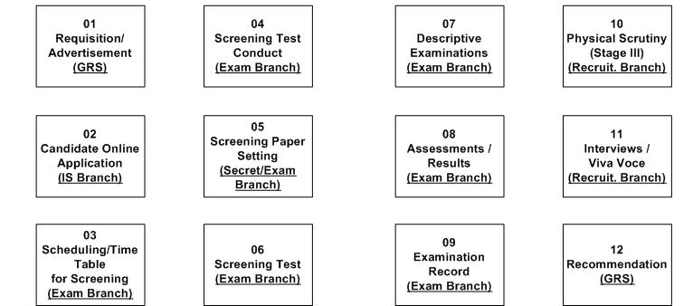
Major systems at SPSC

Slide 9
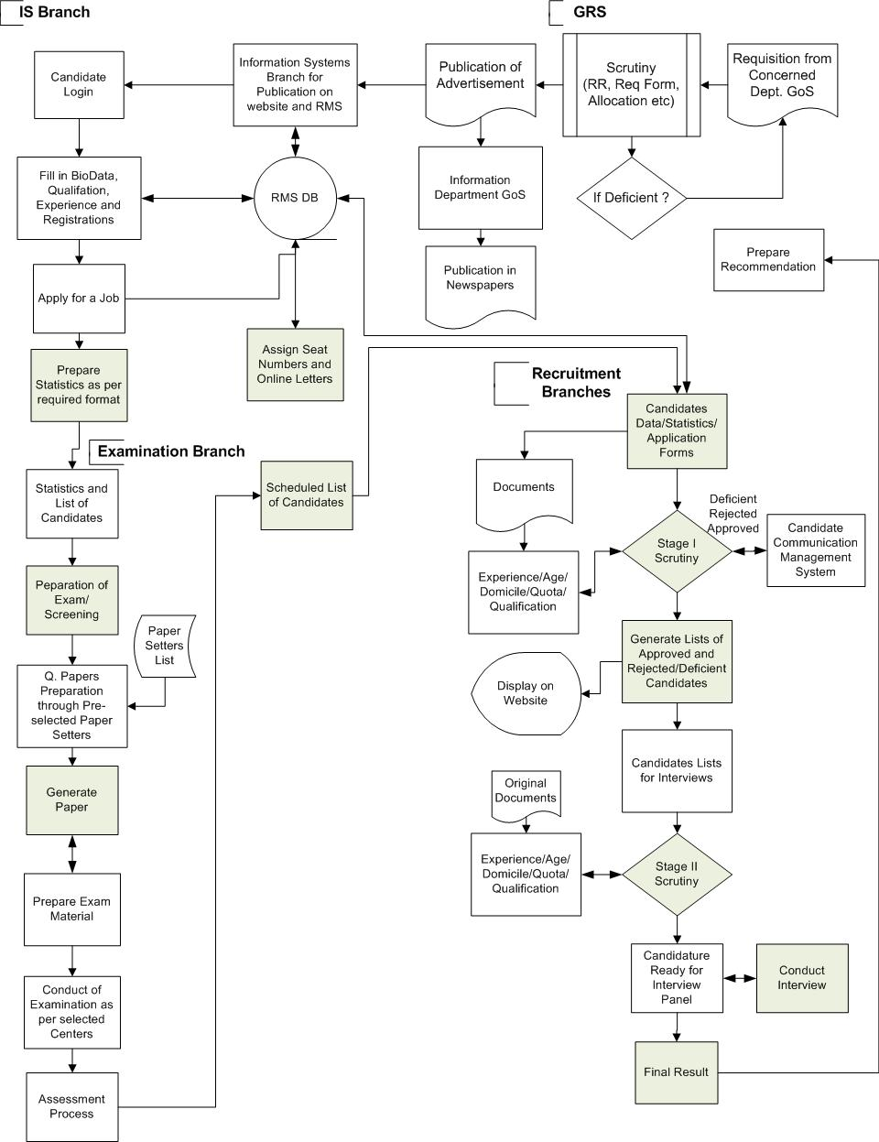
Workflow (AS-IS Model)

Slide 10
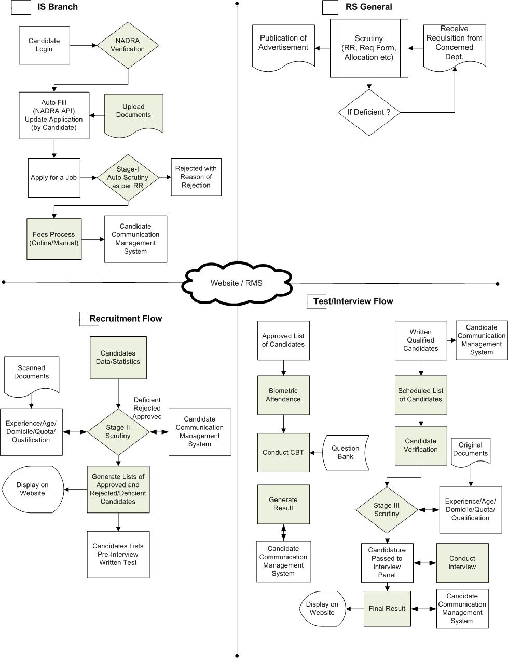
Proposed

Slide 11
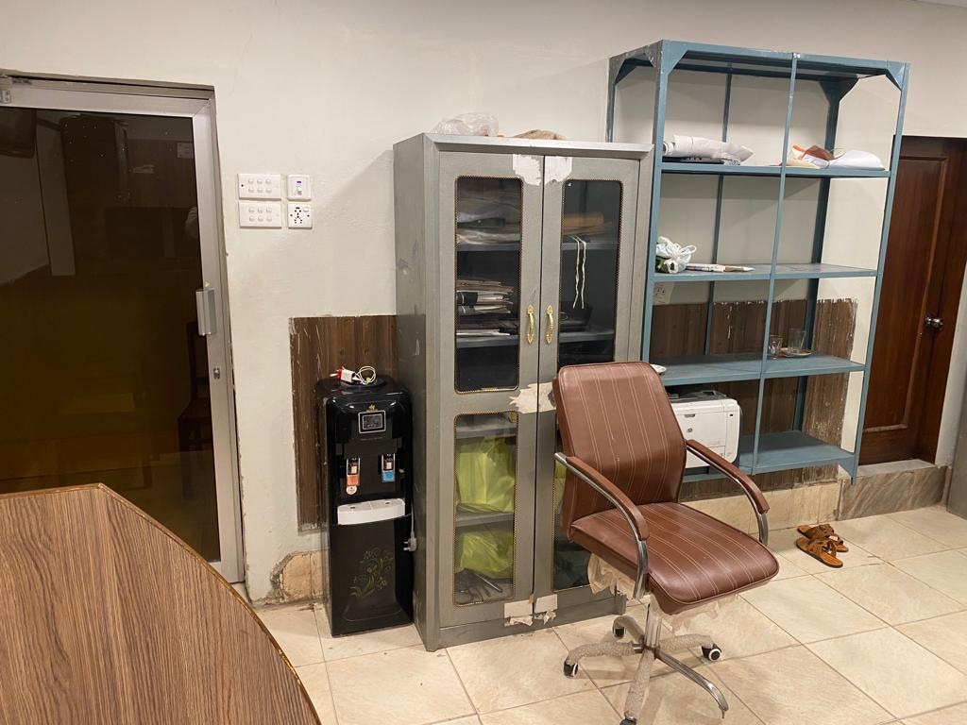
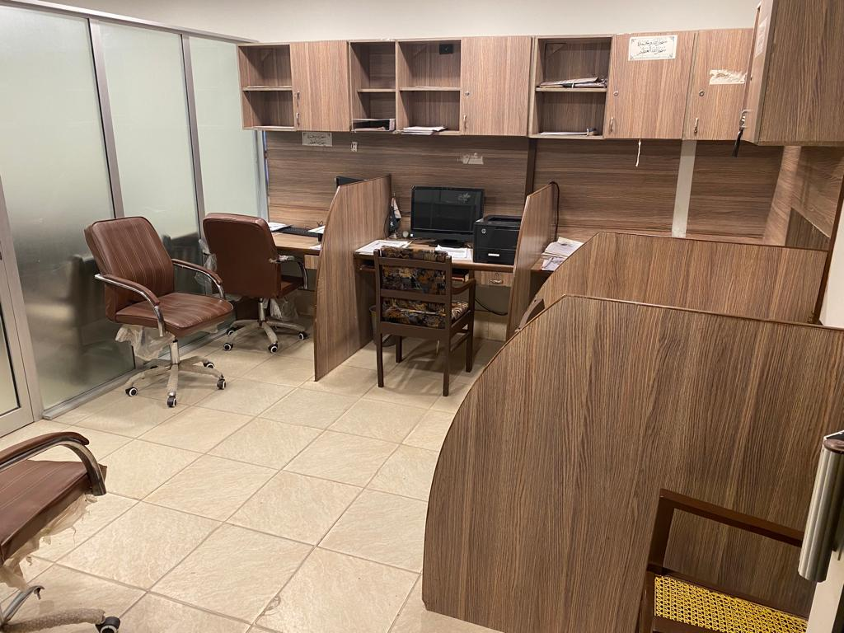
Introduction to IS Branch
Current infrastructure of IS Branch
03 Desktop PC 2010
One laptop 2010
01 Printer 2018
Staff (Total: 04)
01 Deputy Director (BPS-18)
01 Programmer (BPS-17)
01 Senior Data Entry Operator (BPS-16)
01 Data Processing Assistant (BPS-12)

Slide 12
Online Application
Interactive Application process starting from Profile Management
Personal Data
Qualification
Experience
Registrations/Affiliations
Publications

Slide 13
Recruitment Management System (RMS)
Interactive Online Recruitment System
More than 1200k entries in database
Candidates Profile Management System
Candidate Data for Degrees / Registrations / Publications as per HEC Criteria
Online Letters Generation
SMS System
Online Results and Marks Sheets
Generation of all the formats/Reports required for the Examination and Interview

Slide 14
Online Applications Process
Live process

Slide 15
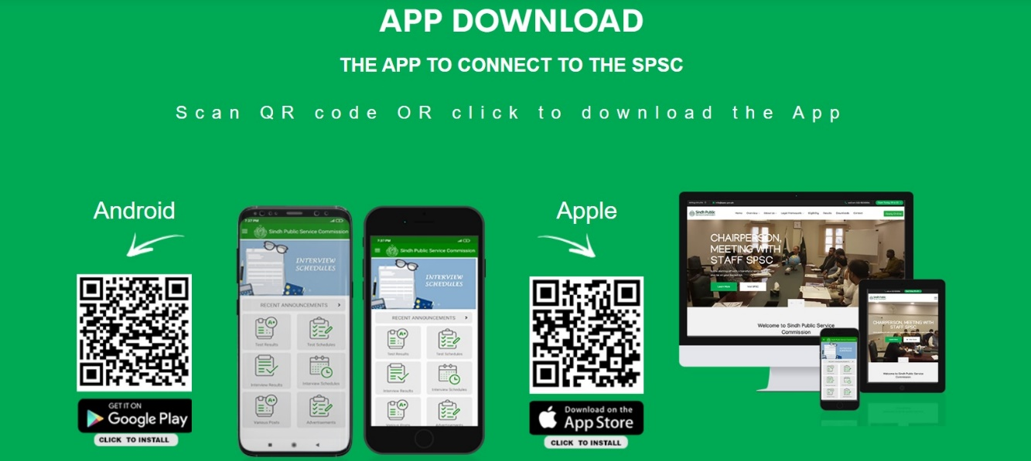
Android & iOS Mobile Apps
Push Notifications right away in hand
Convenient, Easy, Light weight Mobile App
Supports both Android and APPLE Platforms

Slide 16
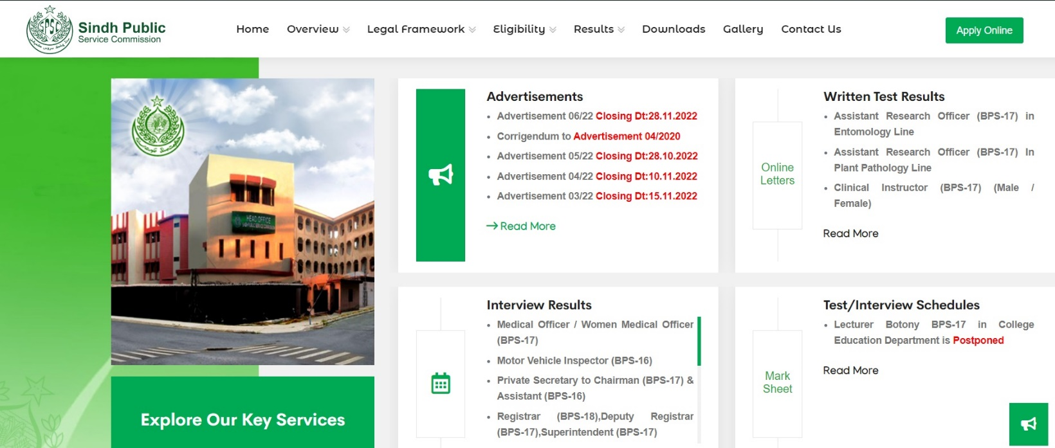
Dynamic Website
Complete New Design (https://www.spsc.gov.pk & https://www.spsc.gos.pk
Friendly, Better Aesthetic & Dynamic Website
Consists Historical Background of SPSC, Legal Framework, Advertisements, Candidate Lists, Test Schedules / Results, Interview Schedules / Results, Downloads (Syllabus, forms, challan), Apply Online, Candidate Profile, Dynamic Contact form, Online Admission letters and much more.

Slide 17
RMS Bottlenecks
Recruitment Management System
Open Code Framework (Increases Risks to be hacked besides malicious attacks)
Old Database Architecture (Creates Bottlenecks and Loss of data)
No Backup Plan – (Tender for Procurement)
No proper Candidate Communication Mechanism
No updates on “Application Status”
Online Fees Module – (In-Process)
No API Integration is possible (NADRA, HEC)
No Smart Applications with Desktop Replication
No facility to Candidate to Upload Documents
Auto Scrutiny Not Possible
Integration/Communication with other Branches and Systems
Communication of Data across Branches not available

Slide 18
Scheduling and Conduct
Auto Scheduling and Paper/Candidate Conflict resolution
Maintaining Centers/Conduct data
Infrastructure Report
Candidates Present/Absent
Pool of Good Invigilators (List of Invigilators)
Center Statistical/Performance/Conduct Report
Center Selection as per history data including nearby factors.
NADRA Verification at Centers to remove impersonation
Examination Record
Interviews
Tab based Secure System @ Committee
Auto Candidate schedules
Candidate Records
Joint Committee - Smart Assessment
Internet Access/ChatGPT
SPSC Bot for Assistance (Pool of Questions to assist Member)
Availability of Test/Exam Copies and allied Credentials
Auto Results/Merit/Recommendation Preparation
NADRA Module for verification

Slide 19
Statistical Data
Recruitment/Examination Data Analytics - availability
Degree Equivalence Data
Data regarding reputed firms
Registration Councils
Recruitment Rules and Seats Allocation
Daily updates/Monthly Reports/Annual Reports
Printing
Predict the requirements in advance as per Advertisements/Applications
Allocate a separate Room for Bulk Printing
Procurement of Stationary in advance
Smart Reception
Ticket based Enquiry System
Record Candidate basic Data
Reason of Visit
Satisfaction/Feedback Recording
Statistics of Issues (Top Issue of the month)
Access to all the information regarding Candidate and Announcements
Well-connected Communication System with Sections/Branches

Slide 20
Data Center
Can Store and Manage Large Amount of Candidate Data
Physical Security, Network Connectivity, Backups and Disaster Recovery
Features to Handle Internal and External Software/Connectivity needs.
Trainings
Training of IT Staff
Training of PA’s and Other Staff on IT Skills
Training of Recruitment Staff on HR latest Tools and Techniques

Slide 21
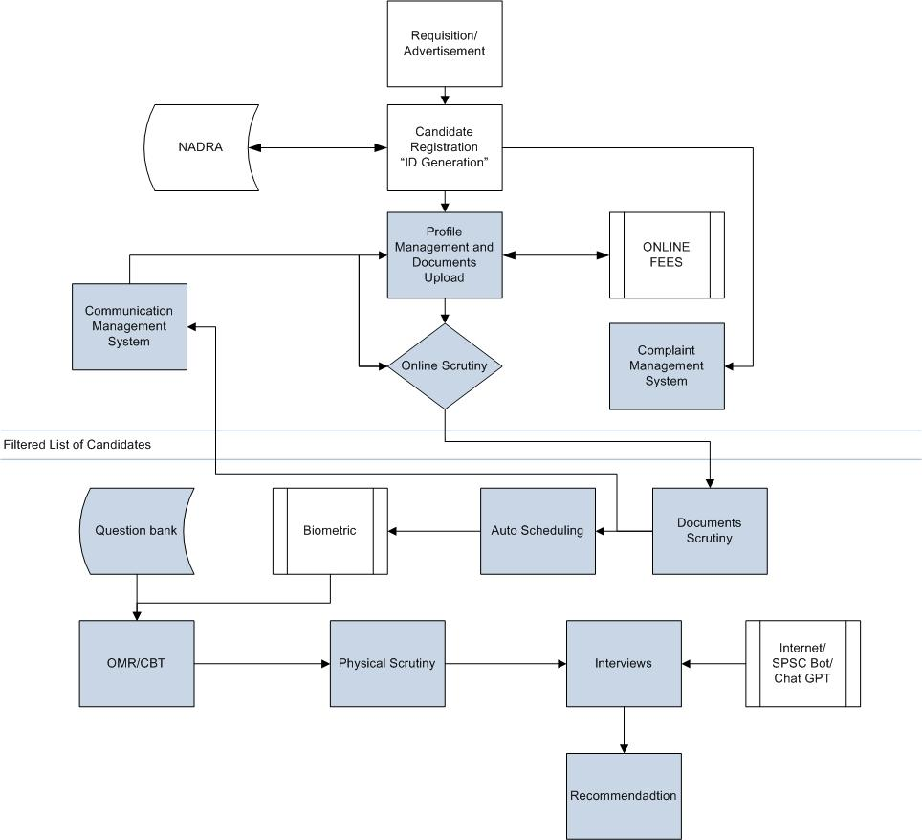
Flow of New System

Slide 22
Examination & Interviews

Slide 23
OMR (Optical Mark Recognition) Process
Technology:
SPSC administering examination through this Efficient and Cost-Effective OMR Technology since 2011
Scanners:
World best Scanners with US based Remark Classic Software Solution Set of 03
Carbon Copy
Transparent Way of Examinations by providing Carbon Copy to Candidates
Easy Results:
Candidates can have their results through their own Assessment.
Experience
CCE Screening (2013-2021): 150,000 (Approx.)
Lecturer: 150,000 (Approx.)
Other Examinations: 1M (Approx.)

Slide 24
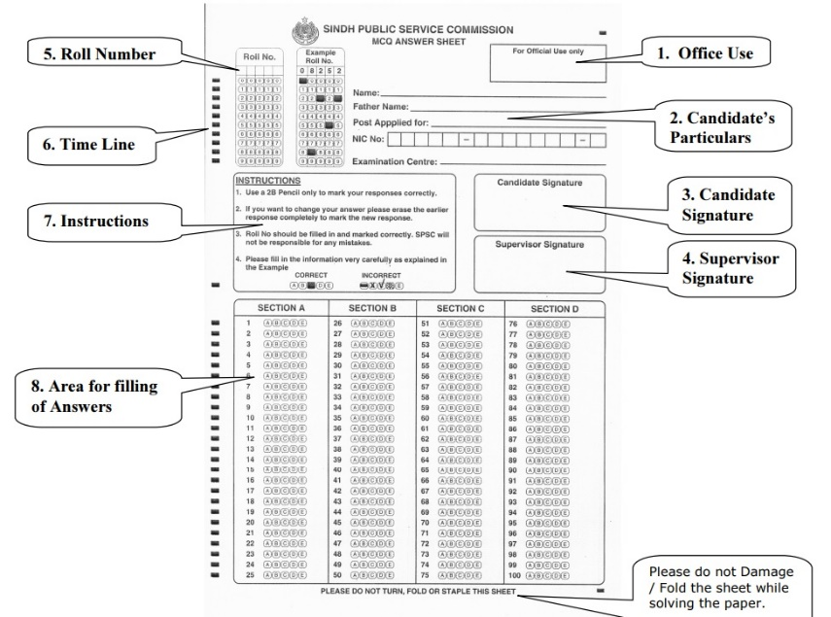
Bottlenecks/Issues need to be addressed
Trained Staff
(One Experienced/Lead and atleast 03 Operators)
Old Scanners (Need Maintenance and Procurement)
Printer Installation (Sheerazi & Co)
Proper Room/Space
Carbon Paper – Carbon less Paper
Candidate Data Errors (Roll Numbers, SPSC Copy)
Policy to Asses and Operate OMR

Slide 25
Reports - Formats

Slide 26
Psychology Department Assessment Plan for SPSC
Psychological Assessment for General Recruitment up to BPS-17.
Psychological Assessment for Competitive Examinations;
Combined Competitive Examination (CCE)/PCSs.
Engineering Cadres.
Medical Cadre.
Law Enforcement Agencies (LEA) i.e. Home Dept.
Administrative Departments. i.e. Local Govt.
BPS-18 and above.

Slide 27
Psychological Assessment in GR
Personal Information Questionnaire(PIQ).
Situational Response Test (SRT). Verbal.
Computer Based Testing
Intelligence Quotient (IQ).
Emotional Quotient (IQ).
Social Quotient (SQ).
Adversity Quotient (AQ).

Slide 28
Psychological Assessment in CEs
Personal Information Questionnaire (PIQ).
Situation Response Test (SRT).
Sentence Completion Test (SCT).
Quotients (IQ, EQ, SQ, AQ).
Draw Pictures (present, past, future).
Autobiography.
Thematic Apperception Test (TAT).
House-Tree-Person (HTP).

Slide 29
Library
Total available collection (50,000)
General Collection : 10,000
Departmental : 4000-5000
Have all the Bibliographic Database in Excel Format
Manual Registration and Issuance Process
Work in progress with KOHA Software

Slide 30
Communication & Document Management System
Overall, a communication/document management system aims to streamline document-related processes, enhance collaboration, improve information retrieval, and ensure document security within an organization
Document Storage and Organization
Versioning Control
Workflow Automation/Paperless Environment
Integration with Other Systems
Mobile Access and Collaboration
Analytics and Reporting

Slide 31
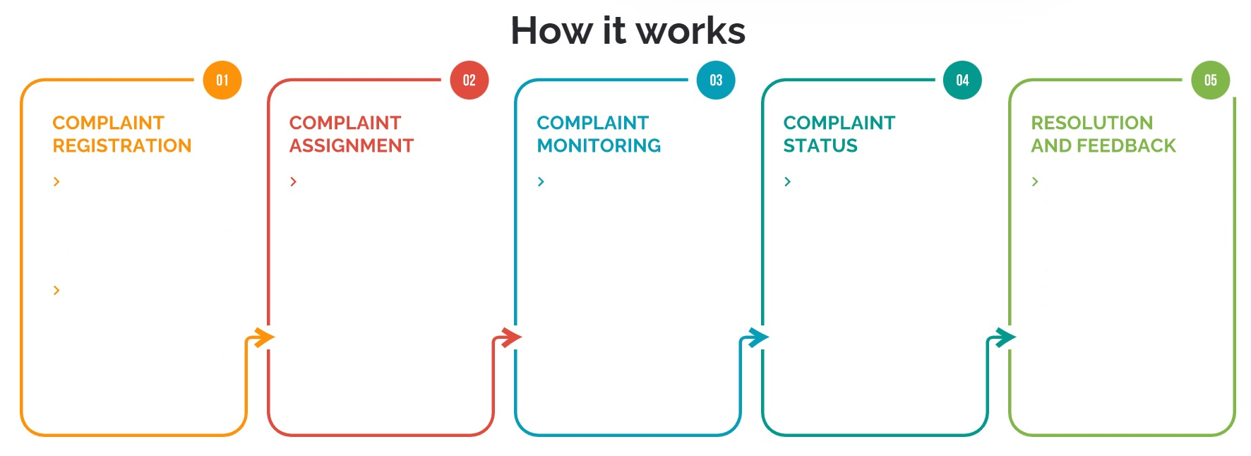
SPSC COMPLAINT MANAGEMENT SYSTEM
HOW IT WORKS
Candidate can lodge a complaint with SPSC Candidate Portal through the Website, RMS, or Mobile App.
An email and SMS is sent out to the candidate after the launch of the complaint containing complaint no. date of the complaint, and expected resolution time.
Depending on the nature of the complaint the system automatically assigns the complaint to the relevant Branch, Section and Head.
The system continuously monitors all the time bound complaints and provides a real-time Dashboard to the Senior Management.
Candidate can check status of their complaint any time using the website and Mobile App
After complaint resolution, Candidate is informed via email and SMS Also to assess the quality of Service

Slide 32
THANK YOU

